Slide 1

INTRODUCTION TO HBASE

Slide 2
HBASE INTRODUCTION
HBase is a distributed column-oriented database built on top of the Hadoop file system.
It is an open-source project and is horizontally scalable.
HBase is a data model that is similar to Google’s big table designed to provide quick random access to huge amounts of structured data. It leverages the fault tolerance provided by the Hadoop File System (HDFS).
It is a part of the Hadoop ecosystem that provides random real-time read/write access to data in the Hadoop File System.
One can store the data in HDFS either directly or through HBase. Data consumer reads/accesses the data in HDFS randomly using HBase. HBase sits on top of the Hadoop File System and provides read and write access.

Slide 3
HDFS | HBase
HDFS is a distributed file system suitable for storing large files. | HBase is a database built on top of the HDFS.
HDFS does not support fast individual record lookups. | HBase provides fast lookups for larger tables.
It provides high latency batch processing. | It provides low latency access to single rows from billions of records (Random access).
It provides only sequential access of data. | HBase internally uses Hash tables and provides random access, and it stores the data in indexed HDFS files for faster lookups.

Slide 4
Rowid | Column Family |  |  | Column Family |  |  | Column Family |  |  | Column Family
 | col1 | col2 | col3 | col1 | col2 | col3 | col1 | col2 | col3 | col1 | col2 | col3
1
2
3

Slide 5
Column Oriented and Row Oriented
Column-oriented databases are those that store data tables as sections of columns of data, rather than as rows of data. Shortly, they will have column families.
Row-Oriented Database | Column-Oriented Database
It is suitable for Online Transaction Process (OLTP). | It is suitable for Online Analytical Processing (OLAP).
Such databases are designed for small number of rows and columns. | Column-oriented databases are designed for huge tables.

Slide 6
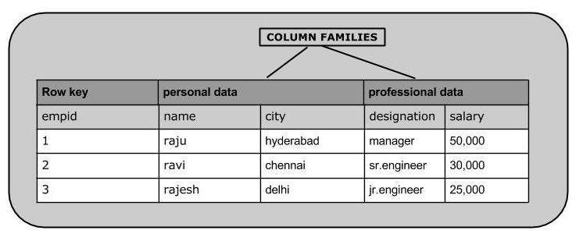

Slide 7
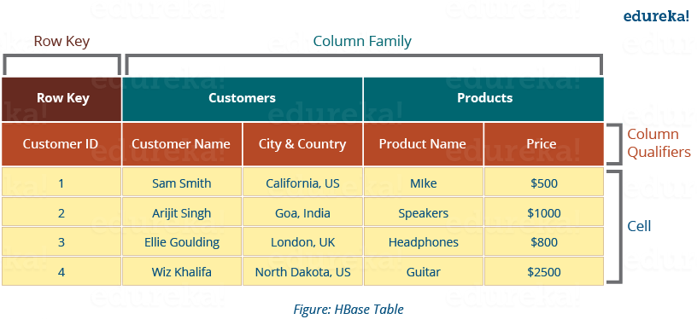

Slide 8
Tables: Data is stored in a table format in HBase. But here tables are in column-oriented format.
Row Key: Row keys are used to search records which make searches fast.
Column Families: Various columns are combined in a column family. These column families are stored together which makes the searching process faster because data belonging to same column family can be accessed together in a single seek.
Column Qualifiers: Each column’s name is known as its column qualifier.
Cell: Data is stored in cells. The data is dumped into cells which are specifically identified by rowkey and column qualifiers.
Timestamp: Timestamp is a combination of date and time.

Slide 9
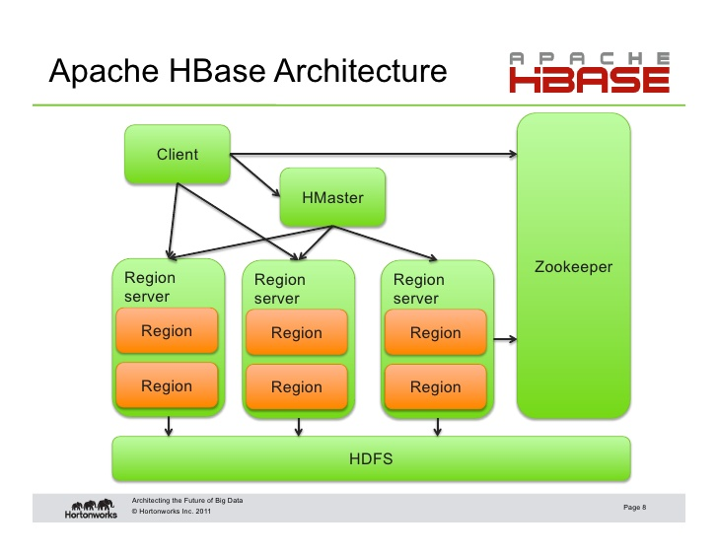
Hbase Architecture

Slide 10
HBase architecture has 3 main components:
HMaster
Region Server
Zookeeper

Slide 11
HMaster
The implementation of Master Server in HBase is HMaster.
It is a process in which regions are assigned to region server as well as DDL (create, delete table) operations.
It monitor all Region Server instances present in the cluster.
In a distributed environment, Master runs several background threads.
HMaster has many features like controlling load balancing, failover etc.

Slide 12
Region Server
HBase Tables are divided horizontally by row key range into Regions.
Runs on HDFS DataNode which is present in Hadoop cluster.
Regions
Basic building elements of HBase cluster
Consists of the distribution of tables
Comprised of Column families.
Responsible for handling, managing, executing as well as reads and writes HBase operations on that set of regions.
The default size of a region is 256 MB.

Slide 13
Zookeeper
Coordinator in HBase.
It provides services such as maintaining configuration information, naming, providing distributed synchronization, server failure notification .
Clients communicate with region servers via zookeeper.

Slide 14
HBase | RDBMS
HBase is schema-less, it doesn't have the concept of fixed columns schema; defines only column families. | An RDBMS is governed by its schema, which describes the whole structure of tables.
It is built for wide tables. HBase is horizontally scalable. | It is thin and built for small tables. Hard to scale.
No transactions are there in HBase. | RDBMS is transactional.
It has de-normalized data. | It will have normalized data.
It is good for semi-structured as well as structured data. | It is good for structured data.

Slide 15
Where to Use HBase
Apache HBase is used to have random, real-time read/write access to Big Data.
It hosts very large tables on top of clusters of commodity hardware.
Apache HBase is a non-relational database modeled after Google's Bigtable. Bigtable acts up on Google File System, likewise Apache HBase works on top of Hadoop and HDFS.

Slide 16
Applications of HBase
It is used whenever there is a need to write heavy applications.
HBase is used whenever we need to provide fast random access to available data.
Companies such as Facebook, Twitter, Yahoo, and Adobe use HBase internally.

Slide 17
Applications of HBase
Medical: The medical industry uses HBase to store the data related to patients such as patient diseases, information such as age, gender, etc., to run MapReduce on it.
Sports: Sports industry uses HBase to store the information related to the matches. This information would help perform analytics and in predicting the outcomes in future matches.
Web: The web is using the HBase services to store the history searches of the customers. This search information helps the companies to target the customer directly with the product or service that they had searched for.
Oil and petroleum: HBase is used to store the exploration data which helps in analysing and predicting the areas where oil can be found.
E-commerce: E-commerce is using HBase to record the customer logs and the products they are searching for. It enables the organizations in targeting the customer with the ads to induce him to buy their products or services.
Other fields: Hbase is being employed in different fields where data is the most important factor and needs to store petabytes of data to conduct the analysis.

Slide 18
HBase History
Year | Event
Nov 2006 | Google released the paper on BigTable.
Feb 2007 | Initial HBase prototype was created as a Hadoop contribution.
Oct 2007 | The first usable HBase along with Hadoop 0.15.0 was released.
Jan 2008 | HBase became the sub project of Hadoop.
Oct 2008 | HBase 0.18.1 was released.
Jan 2009 | HBase 0.19.0 was released.
Sept 2009 | HBase 0.20.0 was released.
May 2010 | HBase became Apache top-level project.

Slide 19
Working with Hbase commands
HBase general commands – Opening of the terminal
create table
list
disable
is_disabled
enable
is_enabled
Describe
Drop
put

Slide 20
11. Get
12. Delete
13. deleteall
14. scan
15. Count
16. truncate

